Slide 1

Quality Attributes for Technical Testing
Software Quality Assurance
Telerik Software Academy
http://academy.telerik.com

Slide 2


The Lectors
Snejina Lazarova
Product Manager
Talent Management System
Dimo Mitev
QA Architect
Backend Services Team

Slide 3

Table of Contents
Quality Attributes for Technical Testing
Technical Security
Security Attacks
Reliability
Efficiency Testing
Maintainability Testing
Portability Testing

Slide 4

Technical Security

Slide 5
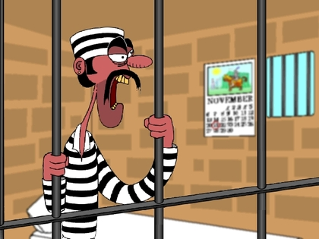
Why Security Testing?
Why bother with security testing?
Security is a key risk for many applications
There are many legal requirements on privacy and security of information
Also many legal penalties exist for software vendors' sloppiness

Slide 6
Security Vulnerabilities
Security vulnerabilities often relate to:
Data access
Functional privileges
The ability to insert malicious programs into the system
The ability to deny legitimate users the use of the system
The ability to sniff or capture data that should be secret

Slide 7
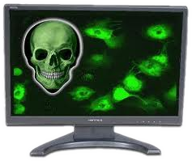
Security Vulnerabilities (2)
Security vulnerabilities often relate to:
The ability to break encrypted traffic
E.g., passwords and credit card information
The ability to deliver a virus or a worm

Slide 8

Side Effects
Increased quality in security can decrease quality in other aspects:
Usability
Performance
Functionality

Slide 9
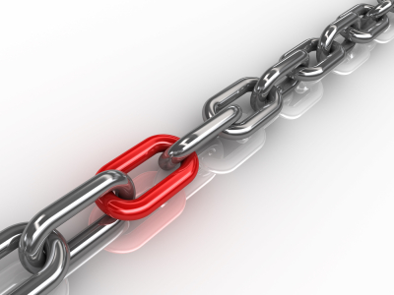
Reliability

Slide 10

Reliability
What is reliability?
The ability of the software product to perform its required functions
Under stated conditions
For a specified period of time
Or for a specified number of operations

Slide 11
Reliability (2)
Important for mission-critical, safety-critical, and high-usage systems
Frequent bugs underlying reliability failures:
Memory leaks
Disk fragmentation and exhaustion
Intermittent infrastructure problems
Lower-than-feasible timeout values

Slide 12

Reliability (3)
Reliability testing is almost always automated
Standard tools and scripting techniques exist
Reliability tests and metrics can be used as exit criteria
Compared to given target level of reliability

Slide 13

Reliability Goals
Software maturity is measured and compared to desired goals
Mean time between failures (MTBF)
Mean time to repair (MTTR)
Any other metric that counts the number of failures in terms of some interval or intensity

Slide 14
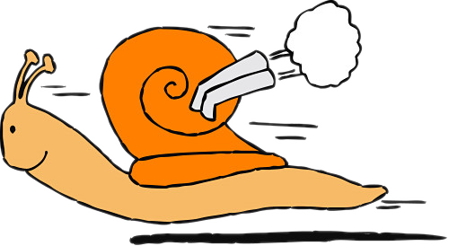
Duration of Reliability Testing
Software reliability tests usually involve extended duration testing
As opposed to hardware testing where reliability testing can be accelerated

Slide 15
Generating Reliability Tests
Tests can be:
Small set of prescripted tests, run repeatedly
Used for similar workflows
Pool of different tests, selected randomly
Generated on the fly, using some statistical model
Stochastic testing
Randomly generated

Slide 16
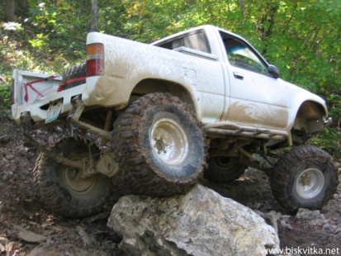
Robustness
What is robustness?
Deliberately subjecting a system to negative, stressful conditions
Seeing how it responds
This can include exhausting resources

Slide 17

Recoverability
Recoverability
The system's ability to recover from some hardware or software failure in its environment
Reestablish a specified level of performance
Recover the data affected

Slide 18
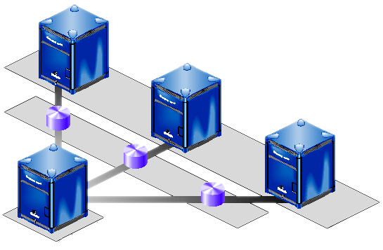
Recoverability Test Types
Failover testing
Applied to systems with redundant components
Ensures that, should one component fail, redundant component(s) take over
Various failures that can occur are forced
The ability of the system to recover is checked

Slide 19
Recoverability Test Types (2)
Backup / restore testing
Testing the procedures and equipment used to minimize the effects of a failure
During a backup/restore test, various variables can be measured:
Time taken to perform backup (full, incremental)
Time taken to restore data
Levels of guaranteed data backup

Slide 20
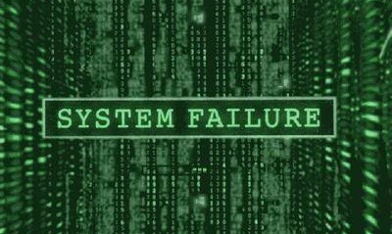
What Counts as a Failure?
Not every bug is a result of a failure that requires recovering
Reliability testing requires target failures to be defined – e.g.:
Operating system or an application crashing
Need to replace hardware
Reboot of the server

Slide 21

Reliability Test Plan
Reliability test plans include three main sections:
Definition of a failure
Goal of demonstrating a mean time between failures
Pass (accept) criteria
Fail (reject) criteria

Slide 22
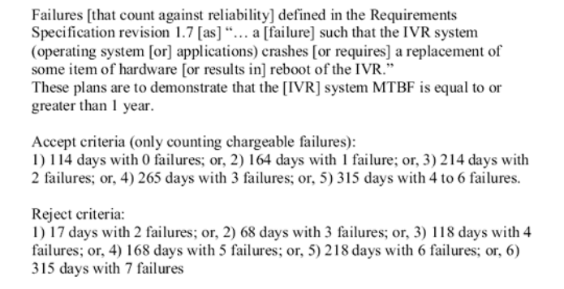
Reliability Testing Example

Slide 23

Efficiency Testing

Slide 24

Efficiency
What is efficiency?
The capability of the software product to provide appropriate performance
Relative to the amount of resources used under stated conditions
Vitally important for time-critical and resource-critical systems

Slide 25

Efficiency Failures
Efficiency failures can include:
Slow response times
Inadequate throughput
Reliability failures under conditions of load, and excessive resource requirements

Slide 26
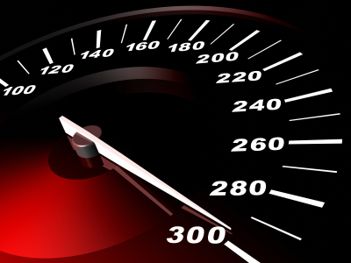
Load Testing
Load testing
Involves various mixes and levels of load
Usually focused on anticipated and realistic loads
Simulates transaction requests generated by certain numbers of parallel users

Slide 27
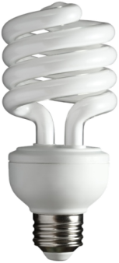
When Should Test for Efficiency?
Efficiency defects are often design flaws
Hard to fix during late-stage testing
Efficiency testing should be done at every test level
Particularly during design
Via reviews and static analysis

Slide 28
Performance Testing
Performance (response-time) testing
Looks at the ability of a component or system to respond to user or system inputs
Within a specified period of time
Under various legal conditions
Can count the number of functions, records, or transactions completed in a given period
Often called throughput

Slide 29
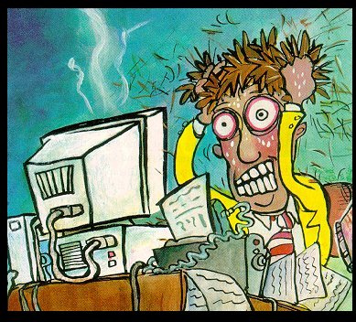
Stress Testing
Stress testing
Performed by reaching and exceeding maximum capacity and volume of the software
Ensuring that response times, reliability, and functionality degrade slowly and predictably

Slide 30



Maintainability Testing

Slide 31
Maintainability
What is maintainability?
The ease with which a software product can be modified:
To correct defects
To meet new requirements
To make future maintenance easier
To be adapted to a changed environment
The ability to update, modify, reuse, and test the system
Notes:
http://www.codeproject.com/Articles/37750/The-Four-Pillars-of-Maintainable-Software
http://www.codeswat.com/cswat/index.php?option=com_content&task=view&id=51&Itemid=71

Slide 32
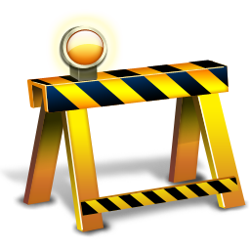
Static Techniques Needed
Maintainability testing should definitely include static analysis and reviews
Many maintainability defects are invisible to dynamic tests
Can be easily found with code analysis tools, design and code walk-throughs

Slide 33
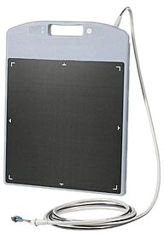
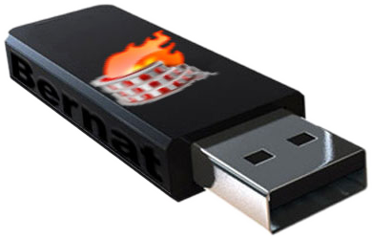
Portability Testing

Slide 34
Portability
What is portability?
The ease with which the software product can be transferred from one hardware or software environment to another
The ability of the application to install to, use in, and perhaps move to various environments

Slide 35

Testing Portability
Portability can be tested using various test techniques:
Pairwise testing
Classification trees
Equivalence partitioning
Decision tables
State-based testing
Portability often requires testing a large number of configurations

Slide 36

Installability Testing (1)
Installability testing
Installing the software on its target environment(s)
Its standard installation, update, and patch facilities are used

Slide 37
Installability Testing (2)
Installability testing looks for:
Inability to install according to instructions
Testing in various environments, with various install options
Failures during installation
Inability to partially install, abort install, uninstall or downgrade
Inability to detect invalid hardware, software, operating systems, or configurations

Slide 38
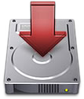
Installability Testing (3)
Installability testing looks for:
Installation requiring too long / infinite time
Too complicated installation (bad usability)

Slide 39
Replaceability Testing
Replaceability testing
Checking that software components can be exchanged for others within a system
E.g., one type of database management system with another
Replaceability tests can be made as part of:
System testing
Functional integration testing
Design reviews

Slide 40
Quality Attributes for Technical Testing
?
?
?
?
?
Questions?
?
?
?
?
?
?

Slide 41




Free Trainings @ Telerik Academy
C# Programming @ Telerik Academy
csharpfundamentals.telerik.com
Telerik Software Academy
academy.telerik.com
Telerik Academy @ Facebook
facebook.com/TelerikAcademy
Telerik Software Academy Forums
forums.academy.telerik.com

